Slide 1
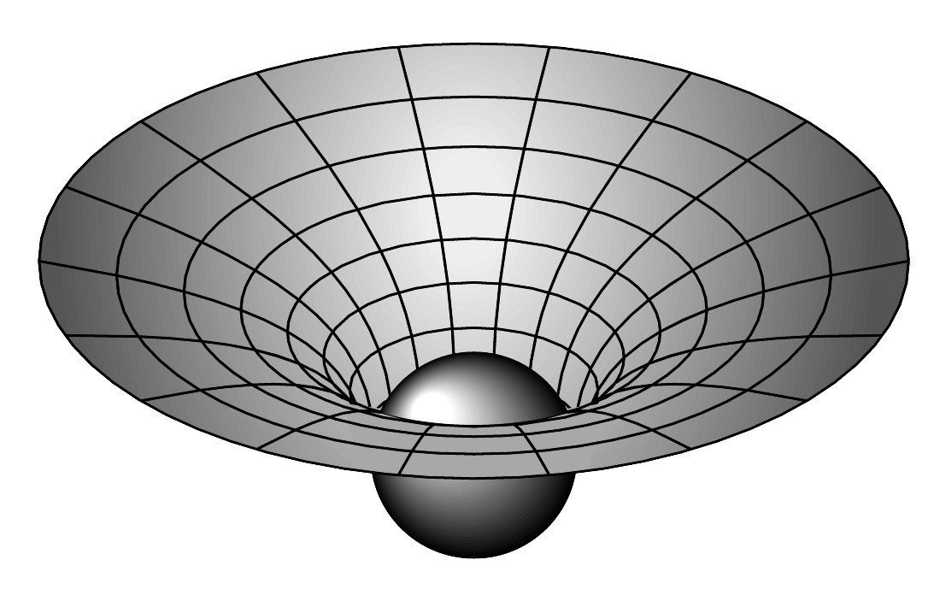


Microscopic black holes and their significance in quantum theories of gravity
Gerard ’t Hooft, Utrecht University
DPG Conference, Hamburg
March 2, 2016
Notes:
Why is grav force so
different
Next: em grav mm
-----
R2

Slide 2
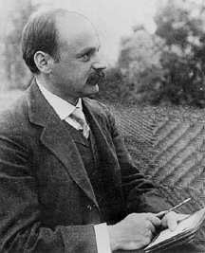
Karl Schwarzschild
1916
“Über das Gravitationsfeld
eines Massenpunktes nach
der Einsteinschen Theorie”
Notes:
New radial coordinate

Slide 3
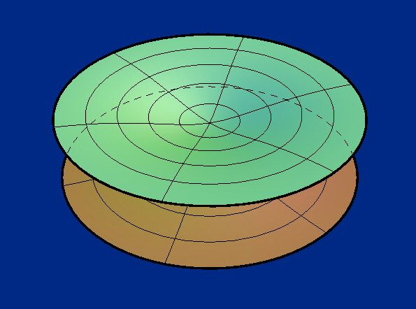
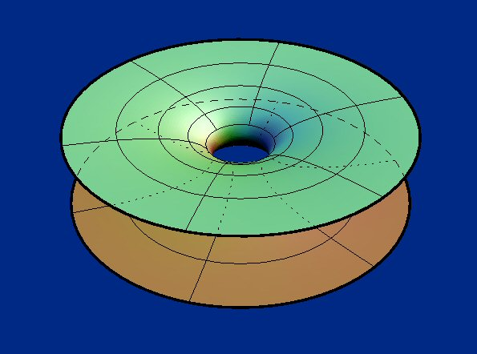
Black Hole
or wormhole?
Universe I
Local observer thinks time continues, moves to singularity
“Time” stands still at the horizon
Universe II
So, one cannot travel from
one universe to the other -
Notes:
Next: 2 astronauts

Slide 4
Where are the strongest possible gravitational fields ?
The field is strongest in the tiniest black holes !

Slide 5
Planck Units
Notes:
Next: highway through desert

Slide 6
The highway across the desert
???
Smallest Black holes?
Planck length:
Quantum Gravity
GUTs
LHC
Notes:
Next instability against implosion

Slide 7
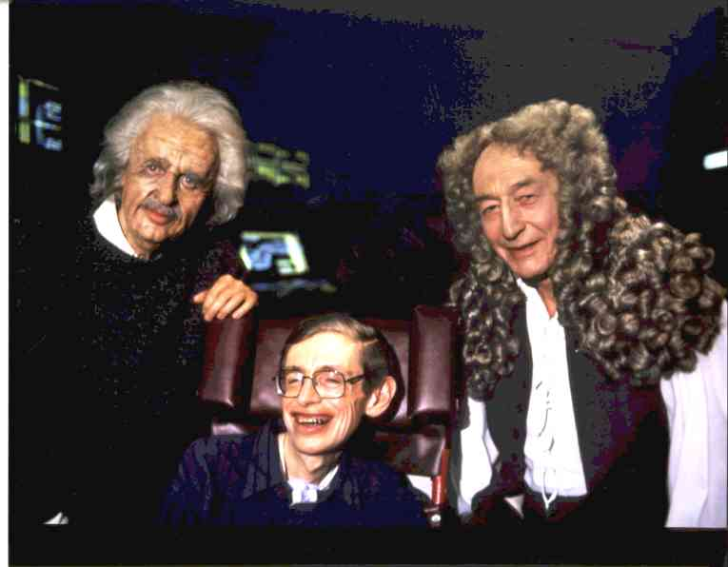
Notes:
Next : Hawking Radiation

Slide 8





Stephen Hawking’s great discovery:
Black hole emits particles !!
Notes:
Next : vacuum fluctuations

Slide 9

While emitting particles, the black hole loses
energy, hence mass ... it becomes smaller.
Lighter (smaller) black holes emit more intense
radiation than heavier (larger) ones
The emission becomes more and more intense,
and ends with ...
Notes:
Next: in clock, ou keys,coins

Slide 10
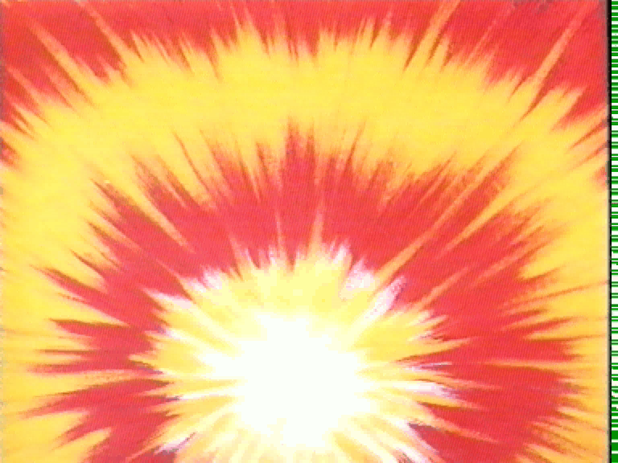

Slide 11


As seen by distant
observer
As
experienced
by astro-
naut
himself
Time stands still
at the horizon
Continues
his way
through
They experience time differently. Mathematics tells us
that, consequently, they experience particles differently
as well
Notes:
Next Hawking, Einstein, Newton in Star Trek

Slide 12
creates
a particle
annihilates
a particle
Horizon
In quantum field theories, Fourier transform a field in the time direction:

Slide 13
But the outside observer defines time t differently from the local observer’s time.
Therefore, they calculate their Fourier coefficients differently, so that
positive and negative ω mix !
The vacuum state is defined by demanding:
only if
And therefore, the vacuum state is not the same for the different observers !

Slide 14
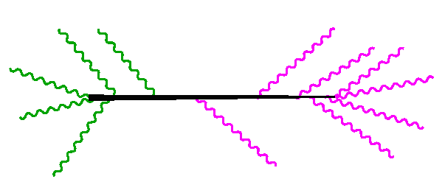
And so it was discovered that
black holes behave much like other forms of matter …
Are black holes just
“elementary particles”?
Are elementary particles
just “black holes”?
Imploding
matter
Hawking particles
Black hole
“particle”
Notes:
Next:
one would expect everything to be computable now

Slide 15
Particles emerging from Black holes (appear to) have an ideal, thermal spectrum:
Hawking particles come from vacuum fluctuations,
and the vacuum (for one given observer)
is the same everywhere.
One then simply derives the
entropy of such black holes.
And with that, the distribution
of their quantum states

Slide 16


If we had the amplitude ,
we could compare the absorption process with the emission process. This gives:
(phase space of heavier BH)
(phase space of lighter BH)
In a black hole:
compare Hawking’s particle emission process
with the absorption process:
➔ same W !!
12
12
9
3
9
3
6
6
Black hole plus matter
➔
➔ black hole plus matter
Heavier black hole

Slide 17

One finds
the black hole as an information processing machine
The constant of
integration: a few
“bits” on the side ...
Notes:
Next: BH = elementary particle

Slide 18
This would suggest black holes obey a Schrödinger equation. And that would imply that they evolve according to a unitary evolution operator …
as usual in quantum mechanics !
But how do we derive the microstates from first principles?
The evolution should be described by a unitary evolution operator, ,
Different in-states should evolve into
different out-states.
How can that be if they went into a black hole?
The Black Hole Information Paradox

Slide 19
The Black Hole Information Paradox
How do the Hawking particles depend on the particles that went into the black hole?
According to Hawking:
Not at all !
Do Hawking’s particles
– derived from applying QM to the Schwarzschild metric –
themselves violate basic QM laws ?

Slide 20

That can’t be right !!
Leonard Susskind,
2008

Slide 21
vacuum
Hawking radiation
vacuum
matter
going
in
Hawking radiation

Slide 22
Horizon
The quantum states in regions I and II are entangled
Region II
Region I
time
entanglement
But the particles in region II cannot be observed – they disappear
space
This seems to prohibit the description of the black hole entire as a single quantum object
Notes:
Next: thermal distribution: mixed state

Slide 23
Alternative theories:
Indeed, loss of quantum coherence;
no pure quantum description of BH
(problem: energy conservation)
Hawking
~ 1975
2. After explosion by radiation:
black hole remnant
(problem: infinite degeneracy of the
remnants)
~ 2000
3a. Information returns in the Hawking radiation, but only at the end.
~ 2015
3b. Information returns in the Hawking radiation, immediately.
Me ~ 1984 - present
Notes:
Next: paradox

Slide 24
interaction
horizon
Notes:
Next: heavy ion scattering, eikonal approximation

Slide 25
By taking back reaction into account, one can study how ingoing particles affect the outgoing ones …
b
❖
Notes:
Next: Black against white holes

Slide 26
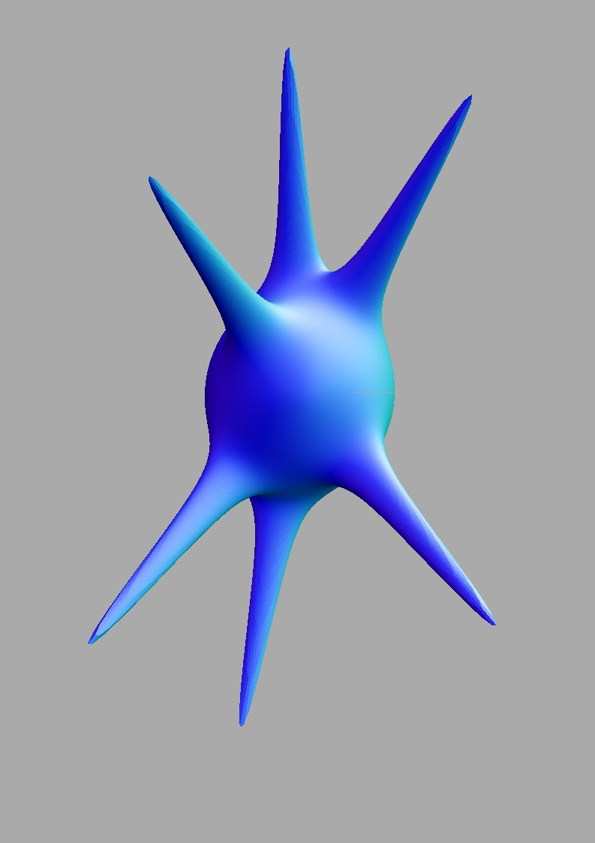
The horizon was a perfect sphere,
until the in- and out going particles distorted it by their gravitational fields.
These calculations turn out to be almost identical to the caculations for the motion of
closed strings
Are black holes described by string theory?

Slide 27


Slide 28
But the main problem with black holes is the question how to handle the quantum states they should form: the microstates.
How is the information describing these microstates encoded on the horizon?
How do the in going particles transform their data onto the Hawking particles going out?
black hole information problem
Conventional string theories describe the formation of higher dimensional “membranes”. Stacks of these membranes take the shape of black holes.
These black holes are usually quite different from
Schwarzschild’s solution. They have maximal charges or
angular momenta. That makes their horizons look quite different.
They do get their microstates as expected. But do we then also understand Schwarzschild’s black hole?

Slide 29
Hawking radiation comes from vacuum fluctuations.
And these fluctuations are correlated!
The gravitational field of the in going particles drags the Hawking particles along !
And this can be calculated.
vacuum
Hawking radiation
vacuum
matter
going
in
Hawking radiation
So the radiation going in does have an effect on the particles coming out.

Slide 30
Recently, we did the calculation more extensively:
Will spherical waves of in-going particles produce spherical waves of outgoing ones? YES ! but …
IV
region II
region I
matter
going
in
Hawking radiation
III
What happens with the particles disappearing into region II ???

Slide 31
Region II must be exactly as physical as region I
But what is it ?
A natural suggestion: points at opposite side of BH !
(antipodal points)
If that is true, it would yield a remarkable “prediction” for the Hawking particles:
the vacuum for a local observer, would correspond to particle-antiparticle pairs for the Schwarzschild observer.
But the antiparticles go into the negative time direction !
Conclusion (tentative): Every Hawking particle at one side of the BH, is 100 % entangled with a particle at the antipodal point !
Only further theoretical analysis can tell us if this is correct …

Slide 32
Black hole information and holography:
The Next Step
A small step for Mankind , …
A giant leap for me !

Slide 33
THE END

